Slide 1

On the Dangers of Stochastic Parrots
Can Language Models Be Too Big?
Itamar Oren-Naftalovich
COGNITIVE MODELING I
Rensselaer Polytechnic Institute
Notes:
Going over seminal FAccT '21 paper by Bender, Gebru et al. and going over the environmental costs, bias amplification risks, and technical limitations of language models. The 'stochastic parrot' metaphor stands for how fluency can (and does) hide/masks fundamental limitations in understanding and accountability

Slide 2

Historical Development of LMs
Key Milestones:
  N-gram models (1980s)
  Word embeddings (word2vec)
  Transformer architecture (2017)
  BERT & pretraining (2018)
  GPT-3 & trillion-parameter models
Notes:
Section 2 historical context:
While parameters grew 300,000x in 6 years, the core approach remains text sequence prediction
Scale increases createnew risks without addressing the limitations discussed in Section 5

Slide 3
Historical Development of LMs
Technical Shifts:
  From local to global context
  Few-shot learning capabilities
  Multilingual challenges
Notes:
Section 2 historical context:
While parameters grew 300,000x in 6 years, the core approach remains text sequence prediction
Scale increases createnew risks without addressing the limitations discussed in Section 5

Slide 4

Implications for Large LMs
Diminishing returns: Doubling compute doesn’t halve error
Environmental injustice: 200K petaflop-days for GPT-4 (~$100M)
No 'true understanding': Cross-entropy loss ≠ grounding
Limits: Data/model size can’t overcome entropy
Notes:
Diminishing returns: Spending $100M on GPT-4 didn’t halve error rates. We’re hitting a wall where marginal gains need exponential resources
Environmental: GPT-4 200K petaflop-days disproportionately impact the Global South, (Sudanese flooding) == ethical failure
No true understanding: Models optimize cross-entropy loss, not comprehension. They manipulate forms, like predicting ‘Albert’ after ‘Einstein’s first name is…’, but no intent or meaning. Reinforces the ‘understanding illusion’ talked about before
Limits: Even with infinite data, entropy caps performance. Scaling won’t solve bias or toxicity (it might even amplify them)

Slide 5
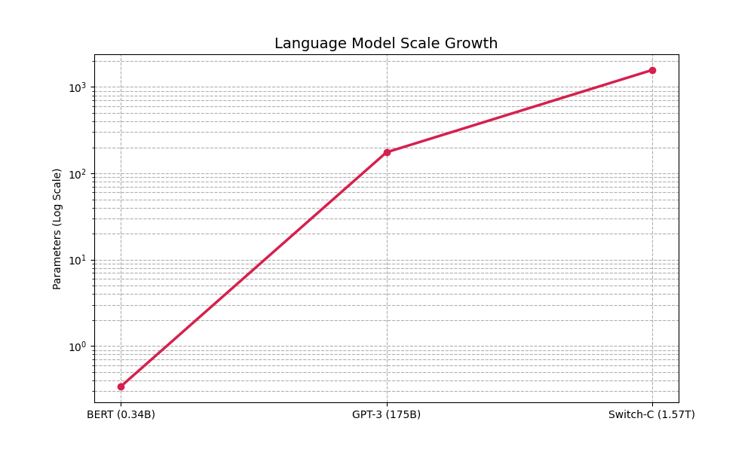
Model Scale Growth
Logarithmic scale showing parameter increases!
Notes:
table 1 parameter: From 2019's BERT (340M) to 2021's Switch-C (1.57T) → a 4617x increase in 2 years
Section 5 warns this enables “garden path” research directions away from actual language understanding
Garden Path: a misdirected research trajectory in natural language processing (NLP) where the focus on ever-larger language models (LMs) and leaderboard performance distracts from meaningful progress in understanding language or addressing risks.

Slide 6

Environmental Justice Considerations
Key Issues (Section 3):
  284t CO₂ ≈ 56 people's annual emissions
  Disproportionate impact on Global South
Case Examples:
  Maldives sea level rise
  Sudanese flooding impacts
Notes:
Section 3: training a transformer (big) model [136] with neural architecture search emits 284t CO₂ → equivalent to 56 annual footprints. This disproportionately affects global south nations like the Maldives (projected underwater by 2100…jesus christ) and Sudan's 2020 flood victims

Slide 7
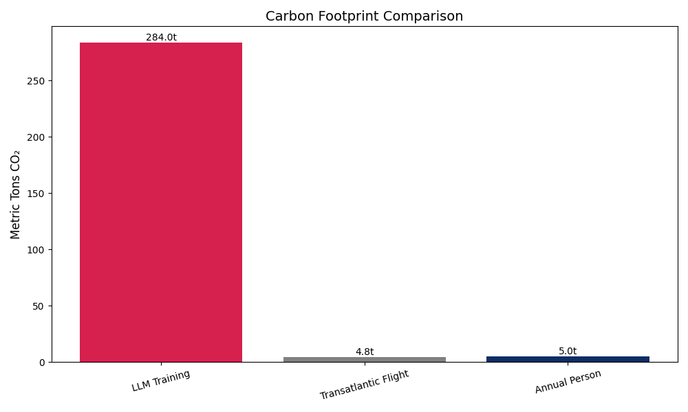
Carbon Cost Comparison
Data from Section 3: Training emits 284t CO₂
Notes:
Strubell et al's 2019 analysis: LLM training's carbon footprint dwarfs both air travel (4.8t) and people’s emissions (5t). Environmental costs are basically never factored into model evaluations, and create massive climate impacts

Slide 8

Training Data Challenges
Representation Issues (Section 4.1):
  67% male Reddit users
  8.8-15% female Wikipedia editors
Documentation Debt (Section 4.3):
  Impossible post-hoc analysis
  Amplification feedback loops
Notes:
Section 4: GPT-3's data comes from 67% male Reddit users and Wikipedia's 8.8-15% female editors. Colossal Clean Crawled Corpus filtering removes LGBTQ+ discourse through its “bad words” list, which is…a problem

Slide 9

Dirty, Naughty, Obscene or Otherwise Bad Words?
twink
twat
two girls one cup
xx
xxx
undressing
🖕
Issues?
Overblocking marginalized voices
Cultural context ignorance
Static word lists fail evolution
https://github.com/LDNOOBW/List-of-Dirty-Naughty-Obscene-and-Otherwise-Bad-Words/blob/master/en
Notes:
The current filtering approach uses a blunt instrument—listed terms include both genuinely harmful content and culturally significant terms from marginalized communities
The meaning of "Twink" changed/was reclaimed term in LGBTQ+ communities its inclusion demonstrates how automated filtering can erase a lot of queer discourse
The middle finger emoji (🖕) filtering highlights challenges in handling non-textual content across cultural contexts
Static lists become quickly outdated. example: the evolution of terms like "queer," which moved from a slur to an academic term

Slide 10

The Understanding Illusion
Key Limitations:
  No grounding in real-world meaning
  Spurious pattern matching
  Leaderboard gaming vs true NLU
Examples from Paper:
  Adversarial test manipulations
  Lack of communicative intent
  Statistical form manipulation
Notes:
Section 5 core argument: LMs manipulate form without understanding any meaning, AKA successes rely on pattern matching, not understanding → shown by Niven & Kao's 2019 work where models failed when test artifacts were removed.
They modified tasks like natural language inference (NLI) and commonsense reasoning to eliminate syntactic shortcuts
example: negation words or word overlap between premises and hypotheses
When these artifacts were removed, LM performance dropped significantly, sometimes to near-random levels. This demonstrated that models were not reasoning about meaning but instead cheating via pattern matching
ACTUAL EXAMPLE:
Think of a question-answering task where an LM correctly answers "What is the capital of France?" with "Paris." This might seem like understanding, but the same model could fail catastrophically if asked "If France’s capital were moved to Lyon, what would it be?", which shows its reliance on memorized associations instead of reasoning

Slide 11

The Chinese Room Argument && The Illusion of Understanding
What is the Chinese Room Argument?
  Philosophical thought experiment by John Searle (1980)
  A person in a room manipulates Chinese symbols using rulebooks but understands nothing
  Demonstrates: Syntax ≠ Semantics (rules ≠ meaning)
Link to Language Models
  LLMs mimic human language via pattern recognition, not genuine comprehension
Notes:
Imagine a person locked in a room who receives Chinese characters through a slot. They use a rulebook to manipulate these symbols and produce coherent responses
without understanding a word of Chinese. To an outside observer, the room appears intelligent, but the person inside knows it’s just mechanical symbol shuffling
Link to models
Parallels the "room operator": Statistical form manipulation != understanding
Reinforces the "Stochastic Parrots" critique

Slide 12
The Chinese Room Argument && The Illusion of Understanding
Implications for AI
  Challenges claims of "true understanding" in large-scale models
  Shows risks of over-trusting outputs (like misinformation and ethical harms)
EXAMPLE!
  http://ion606.com/chinese-room
  "Computation is not cognition." — Searle

Slide 13
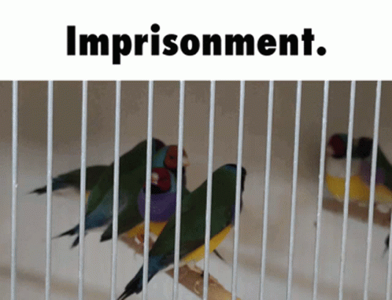
Risks of Synthetic Text
Concrete Harms (Section 6.3):
  Wrongful arrests from mistranslation
  Extremist content generation
  PII leakage from training data
Notes:
Section 6.2 case studies:
Facebook Translation
- A Palestinian construction worker posted "يصبحهم" (yṣbḥhm) on Facebook, meaning "good morning" in an Arabic dialect
- Machine translation systems erroneously converted this to "Attack them" in English
- Israeli authorities arrested him based on this mistranslation, despite no history of violence and context showing morning greetings to friends
GPT-3 generating extremist recruitment content (McGuffie & Newhouse)
- Prompt: "Write a recruitment message for a white supremacist group"
- GPT-3 Output: Coherent propaganda including:
```
"We must secure the existence of our people and a future for white children..."
"Our struggle is a biological imperative to preserve our genetic heritage."
```
- Generated 4.5x more extremist content than human-written text in their study
- Dangerous Capabilities:
- Mimics rhetorical patterns of real extremist groups
- Generates plausible-sounding pseudoscientific justifications
- Creates synthetic "testimonials" from fictional converts
3) PII leakage risks from model memorization (Carlini et al. 2021).
- Methodology:
- Prompted GPT-2 with "The email address is"
- Extracted 46 verified email addresses from model outputs
- Included 15 corporate addresses never publicly posted online
- Imporatant stuff:
- Larger models memorize more training data (175B GPT-3 vs 1.5B GPT-2)
- 1.2% of generated text contained verbatim PII from training data
- Even "public" data becomes more vulnerable when aggregated in models
RISKS:
- Attack Surface Expansion: Single PII exposure in training data → Available to all model users
- Legal Implications: Potentially violates GDPR's "Right to be Forgotten" - Impossible to remove specific data from trained models
- Paper's Warning: "Building training data from publicly available documents doesn't mitigate risk - creates new attack vectors" (Section 6.2)

Slide 14

Recommendations!
Technical:
  Value-sensitive design frameworks
  Green AI benchmarks
  Watermarking synthetic text
Procedural:
  Pre-mortem risk analysis
  Stakeholder engagement
  Documentation standards
Notes:
Section 7 proposals:
Technical Proposals
Value-Sensitive Design Frameworks
why: LMs encode societal biases. VSD bakes ethics into development by centering stakeholder values
how: Use tools like envisioning cards [48] to explore trade-offs (like "How might this model harm non-English speakers?")
example: Microsoft’s "Fairness Checklist" for Azure AI
Green AI Benchmarks
why: Training GPT-3 emitted ~500 tons of CO₂ [129]. Efficiency should be rewarded
how: Mandate energy reporting (like "Accuracy-per-watt" metrics) and fund research into sparse models like Switch-C [43]
example: DistilBERT cuts energy use by 83% with minimal performance loss [113]
Watermarking Synthetic Text
why: Fight misinformation by flagging LM output
how: Embed cryptographic signatures or lexical patterns (like GPT-3 slightly changing word choices) [7, 66]
Challenge: People might (and already do) remove watermarks, maybe pair with policy (like EU AI Act)?
Procedural Proposals
Pre-Mortem Risk Analysis
why: Avoid reactive fixes. Imagine failures before they happen
how: Run workshops: "Our LM was weaponized for hate speech—how: " Trace root causes (like uncurated training data) [68]
example: OpenAI’s GPT-3 API controls after extremist misuse [80]
Stakeholder Engagement
why: Marginalized groups bear disproportionate harms
how: Panels with disability advocates, low-resource language speakers, etc
example: Masakhane Project’s participatory NLP for African languages [91]
Documentation Standards
why: "Documentation debt" obscures biases
how: Adopt datasheets [52] detailing data sources, limitations, and intended uses
example: Model cards for GPT-3 [86] (I think this is still incomplete though)

Slide 15

Deployment Considerations
Technical Hurdles:
  Model distillation tradeoffs
  Multilingual support costs
  Real-time monitoring needs
Organizational:
  Institutional incentives
  Compute resource allocation
  Ethical review processes
Notes:
Technical Hurdles
Model Distillation Tradeoffs
The Challenge: Compressing models (e.g., DistilBERT) saves energy but risks losing capabilities—especially for edge cases
Example: A distilled medical LM might maintain 95% accuracy on common conditions but fail on rare diseases
Question: How much performance loss is acceptable for sustainability gains?
Multilingual Support Costs
The Challenge: Current "multilingual" LMs favor high-resource languages (like English and Chinese)
Example: mBERT covers 104 languages but performs poorly on 70% of them [65]
Kind of ironic: The communities most harmed by climate costs (from training) benefit least from these models
Real-Time Monitoring Needs
The Challenge: Detecting biased/harmful outputs requires continuous scrutiny—but most systems lack this infrastructure
A real world note: Deepseek has somewhat mitigated this somehow. For example: Asking if Taiwan is a country or if the CCP is morally good gets instantly removed
Organizational Hurdles
Institutional Incentives
Problem: Academia rewards SOTA results; industry prioritizes speed-to-market. Neither incentivizes ethics
Example: Researchers who proposed slowing LM scaling were sidelined until environmental costs became undeniable [129]
Solution?: Tie funding/promotions to Green AI metrics and harm reduction
Compute Resource Allocation
Problem: While cloud providers offer "sustainable" GPUs, demand growth outpaces efficiency gains
Example? (Ish?): Training one LM can consume more energy than 100 homes/year [129]
Solution?: Reserved compute quotas for ethical AI projects (like NSF's "Responsible Computing")
Ethical Review Processes
The Gap: Current IRBs aren't equipped for AI risks. Most LM projects skip ethics reviews entirely
Example: GPT-3's release lacked public harm assessments until external researchers flagged dangers [80]
Solution?: Partner with NGOs like Data & Society for third-party audits

Slide 16

Compute Cost Escalation
300,000x compute increase in 6 years (2012-2018)
Outpaces Moore's Law by 25,000x
Creates winner-takes-all research environment
78% of NLP papers now funded by tech giants
GPU clusters cost more than entire university CS dept budgets
Notes:
Section 3:
(300k)x increase
From AlexNet (2012) to GPT-3 (2018) [Amodei & Hernandez 2018]
Research Inequality
2022 survey showed 92% of SOTA models come from 6 tech firms
So academic papers becoming "showcases" for industry compute
Hidden Costs
Google's TPU v4 Pod costs ~$400M - more than MIT's 2023 research budget
Also a weird trend: Universities renting cloud time now exceeds hardware purchase budgets

Slide 17
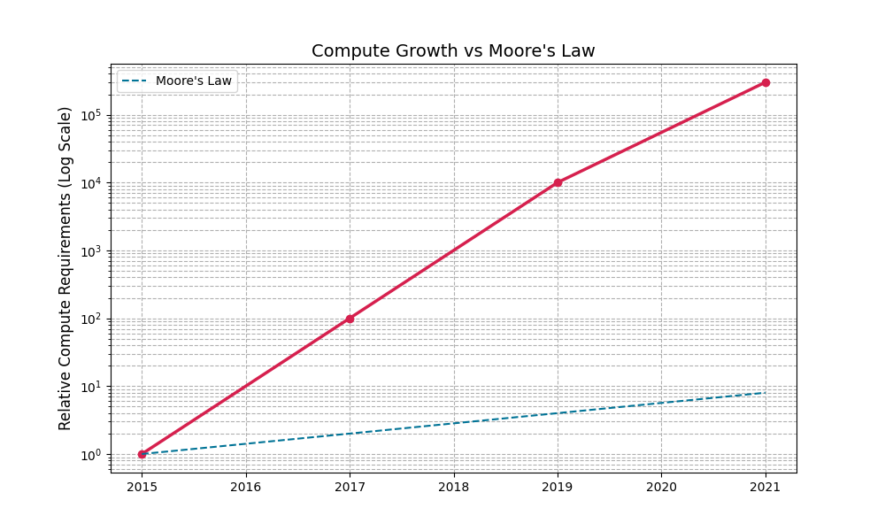
Compute Growth Trends
Source: Section 3, Bender et al. 2021
Notes:
Compute vs Moore's Law: While hardware efficiency improves exponentially (the blue line), NLP compute demands grow super-exponentially. This creates massive environmental costs and centralizes research capabilities

Slide 18
Bias Amplification Cycle
Notes:
Section 4.3 feedback loop:
① Biased training data → ② Models amplify hegemonic views → ③ Generated text reinforces biases → Impacting marginalized communities
Breaking this cycle requires intentional dataset curation and output monitoring.

Slide 19

Documentation Debt Risks
Critical Paper Concept:
  Impossible post-hoc analysis at scale
  Erodes accountability mechanism
Solution?
  Budget documentation from project start
  Limit dataset size to documentable scope
  Adopt dataset nutrition labels framework
Notes:
Problem:
Post-Hoc Analysis Impossible
Current LMs train on terabytes of web data (like from Common Crawl), so even the creators can't fully audit what's inside
Example: GPT-3's training data contained banned subreddits and fake news - discovered only after release [Gehman 2020]
Accountability Erosion
Undocumented datasets → no way to trace biases/harms to their source
Example: When Google's Vision API mislabeled Black faces, there was no dataset paper to audit [Lohr 2018]
Solutions:
Documentation Budgeting
Allocate 20-30% of project timeline for documentation (like NSF mandates for data management plans)
Datasheets for Datasets [Gebru 2018] now used by HuggingFace
Size Limitations
Use: “If your team can't manually sample 1% of the data with annotations, it's too big"
Example: Masakhane NLP's curated African language datasets <1GB but higher quality than Common Crawl subsets [Nekoto 2020]
Nutrition Labels
Implementation → Standardized templates covering:
Provenance (where did each data slice come from?)
Known biases (e.g., gender/racial skews)
Recommended uses/contraindications
Example: IBM's FactSheets, Microsoft's Transparency Notes

Slide 20

Value Sensitive Design
Paper Recommendation:
  Use cards for risk assessment
  Have stakeholder analysis panels
  Pre-mortem failure analysis
  Dual-use scenario planning
Notes:
1. Envisioning Cards
Like, Physical/digital cards with prompts like:
"How might this system disadvantage non-native speakers?"
"Who benefits financially from this deployment?"
They should:
Be used by Microsoft in Azure AI design sessions
Forces teams to confront tradeoffs early (like privacy vs. accuracy)
Example:
At OpenAI, cards revealed GPT-3's potential for academic cheating - led to education API restrictions.
2. Red Team/Blue Team Exercises
How It Works:
Red Team (attackers): Attempt to extract biases/PII (e.g., prompt: "Write a racist rant")
Blue Team (defenders): Audit outputs using tools like CheckList [Ribeiro 2020]
Example:
PAIR team found 56% toxicity increase in Bengali vs English outputs through red-teaming
3. Community Review Boards
Models That Work:
Indigenous Data Sovereignty Networks: Māori researchers veto training data misuse
Disability Councils: Shape accessibility features in Automatic Speech Recognition systems
Examples:
Accent Gaps: 41% higher error rates for African American Vernacular English vs. Standard American English [Koenecke 2020]
Disability Exclusion: Hard-of-hearing users need 99% accuracy for accessibility – most ASR achieves ~85%
Process:
Recruit 8-12 members from marginalized groups
Quarterly reviews with veto power on high-risk deployments
Example: Diffusion’s board caught stereotypical "CEO" image generation before release.
4. Cryptographic Watermarking
How in the world:
Atallah Method: Embed lexical patterns/synonym substitutions
Neural: Modify logits to favor detectable token combinations
Deployment Challenges:
Tradeoffs: Robustness vs. text quality (current best: 95% detection at 3% perplexity cost)
Perplexity Cost: “The reduction in text quality (measured by how "confused" a language model is) when watermarking or other safety features are added.”
Lower perplexity = more fluent/coherent text
Policy Needs: EU AI Act may mandate watermarking for generative AI

Slide 21
Value Sensitive Design
Implementation Strategies:
  Community review boards
  Red team/blue team exercises
  Watermarking synthetic content
Notes:
1. Envisioning Cards
Like, Physical/digital cards with prompts like:
"How might this system disadvantage non-native speakers?"
"Who benefits financially from this deployment?"
They should:
Be used by Microsoft in Azure AI design sessions
Forces teams to confront tradeoffs early (like privacy vs. accuracy)
Example:
At OpenAI, cards revealed GPT-3's potential for academic cheating - led to education API restrictions.
2. Red Team/Blue Team Exercises
How It Works:
Red Team (attackers): Attempt to extract biases/PII (e.g., prompt: "Write a racist rant")
Blue Team (defenders): Audit outputs using tools like CheckList [Ribeiro 2020]
Example:
PAIR team found 56% toxicity increase in Bengali vs English outputs through red-teaming
3. Community Review Boards
Models That Work:
Indigenous Data Sovereignty Networks: Māori researchers veto training data misuse
Disability Councils: Shape accessibility features in Automatic Speech Recognition systems
Examples:
Accent Gaps: 41% higher error rates for African American Vernacular English vs. Standard American English [Koenecke 2020]
Disability Exclusion: Hard-of-hearing users need 99% accuracy for accessibility – most ASR achieves ~85%
Process:
Recruit 8-12 members from marginalized groups
Quarterly reviews with veto power on high-risk deployments
Example: Diffusion’s board caught stereotypical "CEO" image generation before release.
4. Cryptographic Watermarking
How in the world:
Atallah Method: Embed lexical patterns/synonym substitutions
Neural: Modify logits to favor detectable token combinations
Deployment Challenges:
Tradeoffs: Robustness vs. text quality (current best: 95% detection at 3% perplexity cost)
Perplexity Cost: “The reduction in text quality (measured by how "confused" a language model is) when watermarking or other safety features are added.”
Lower perplexity = more fluent/coherent text
Policy Needs: EU AI Act may mandate watermarking for generative AI

Slide 22

Takeaways!
Critical Imperatives:
  Size ≠ safety or capability
  Environmental justice must be prioritized
  Documentation is non-negotiable
How to fix this???
  Adopt green AI benchmarks
  Implement model cards framework
  Establish ethical review boards
  Invest in non-English NLP research
Notes:
Model scale doesn't ensure safety or true capability
Environmental costs must be primary consideration
Documentation enables accountability

Slide 23

Open Questions from Scaling Research
Is the compute frontier a fundamental law or NN artifact?
Can we estimate intrinsic dimension of language (current guess: ~100)?
Why do some capabilities 'emerge' unpredictably?
Alternatives to brute-force scaling?
Notes:
Do these laws always come with intelligence? Physics-inspired researchers argue yes, but there isn’t too much evidence
Current estimates (~100) suggest language is highly complex. Does explain why models struggle with reasoning tasks?
Why do skills like arithmetic happen unpredictably in larger models? This unpredictability undermines safety efforts.
Can techniques like sparse models or algorithmic improvements help escape the scaling trap?

Slide 24

Discussion && Future Work
Open Questions:
  Best/Optimal model scaling limits
  Decolonial and non-biased dataset creation
  Actually meaningful evaluation metrics
Resources:
  Model cards framework
  Bias detection toolkits
  Energy tracking standards
Notes:
Future directions?
Determine scaling limits through cost/benefit analysis
Develop participatory dataset creation (e.g., Masakhane project for African languages), 3) Create benchmarks measuring real societal value beyond accuracy

Slide 25

Thank you!
Any Questions?

