Slide 1
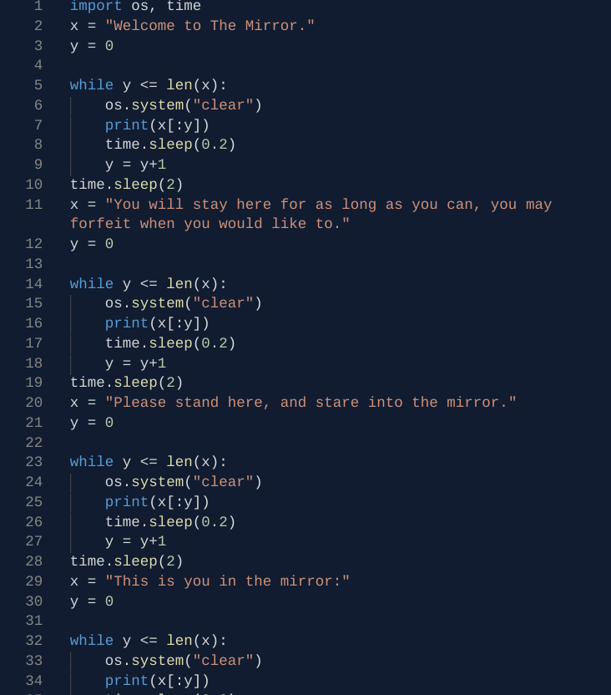
Did Stack Overflow Answers
Increase After ChatGPT?
Data Analytics Final Project
Itamar Oren‑Naftalovich

Slide 2
Research Question
Has the volume of answers on Stack Overflow changed since ChatGPT’s launch (Nov 2022)?
Do moderation policies or community events drive additional changes?
Are heavy ChatGPT users substituting away from Stack Overflow?
Why: generative AI and moderation stresses may threaten the sustainability of Stack Overflow

Slide 3


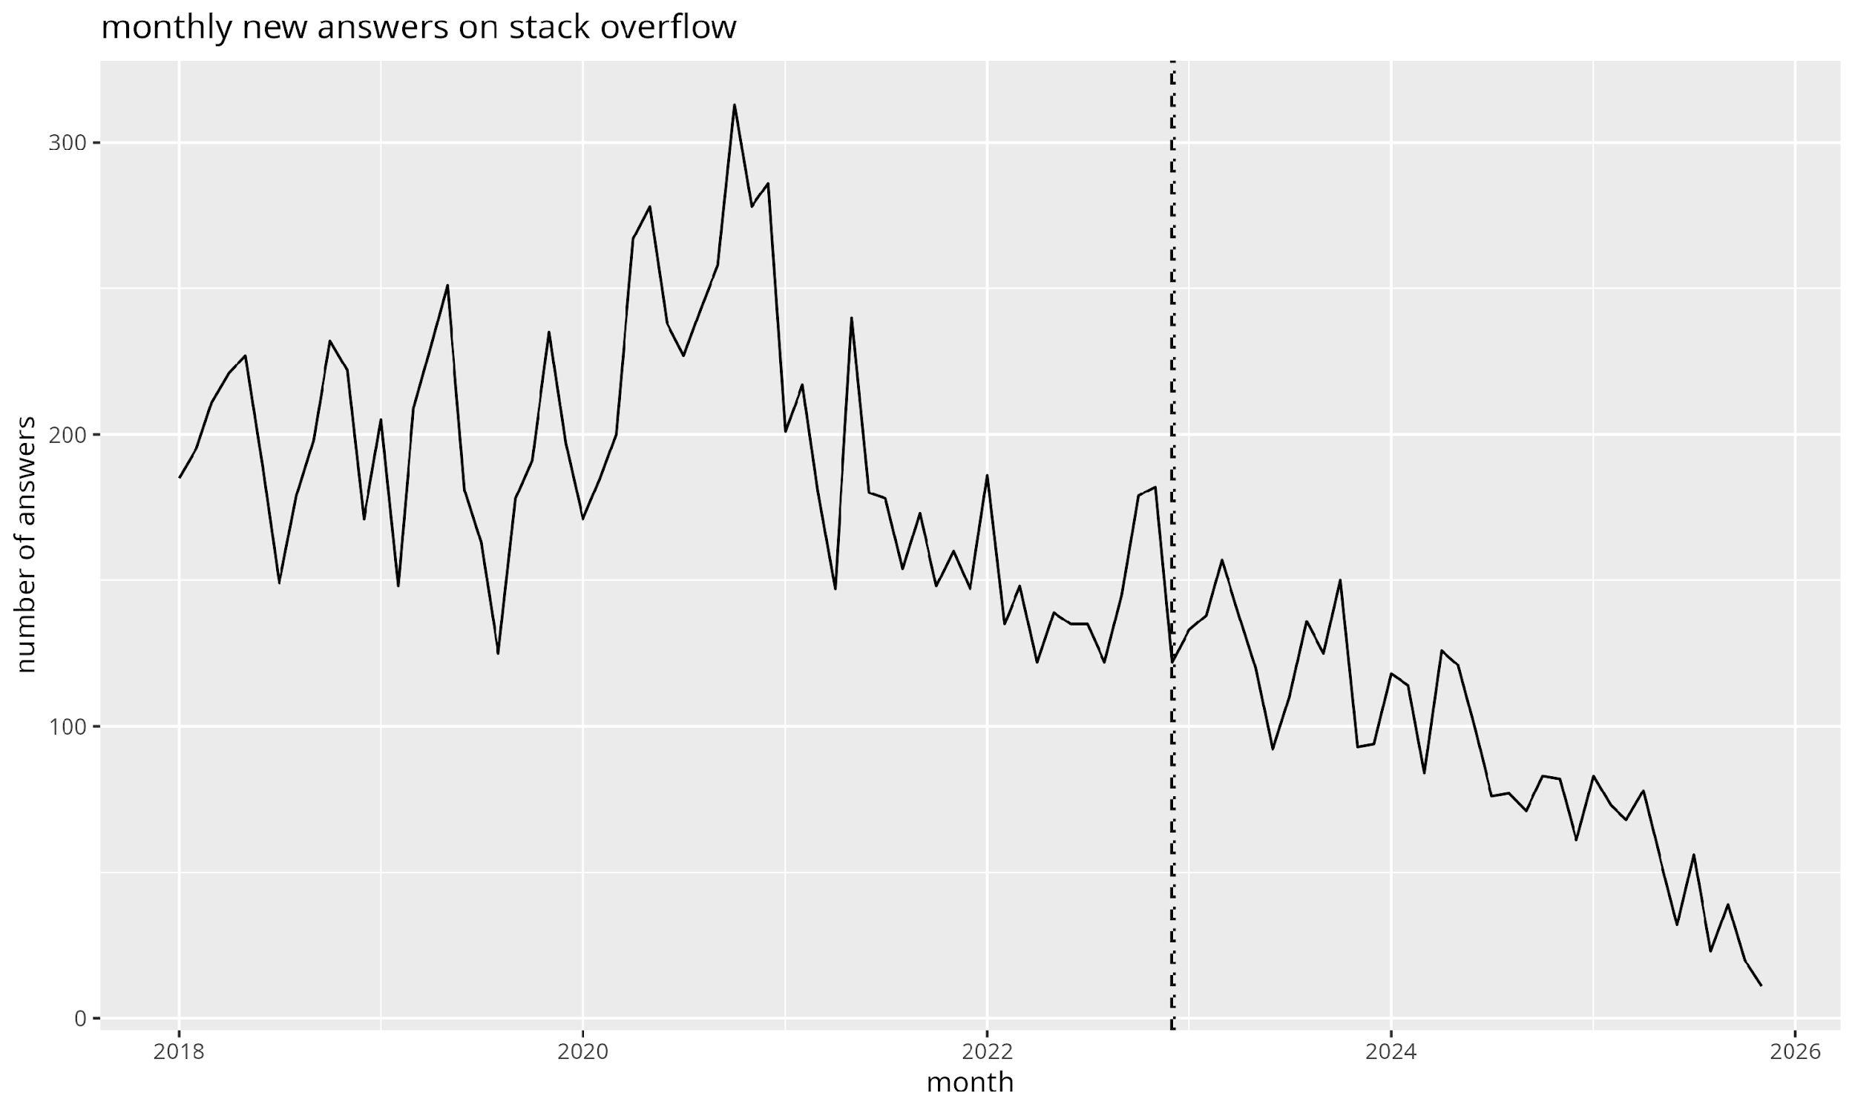
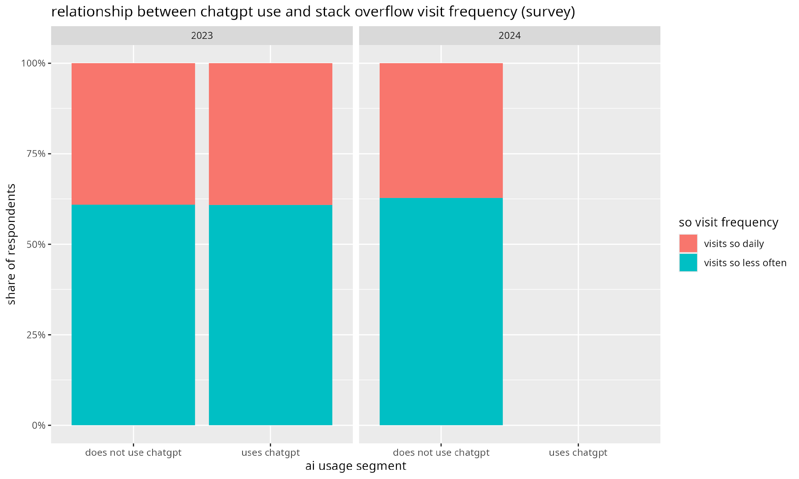
Data Sources
Developer Surveys (2023–2024)
SO’s annual survey capturing visit frequency and AI tool adoption. Used to correlate behaviour with ChatGPT usage.
Monthly Answers (2018–2025)
Extracted from Stack Exchange Data Explorer, including deleted posts. Provides baseline activity and seasons.

Slide 4
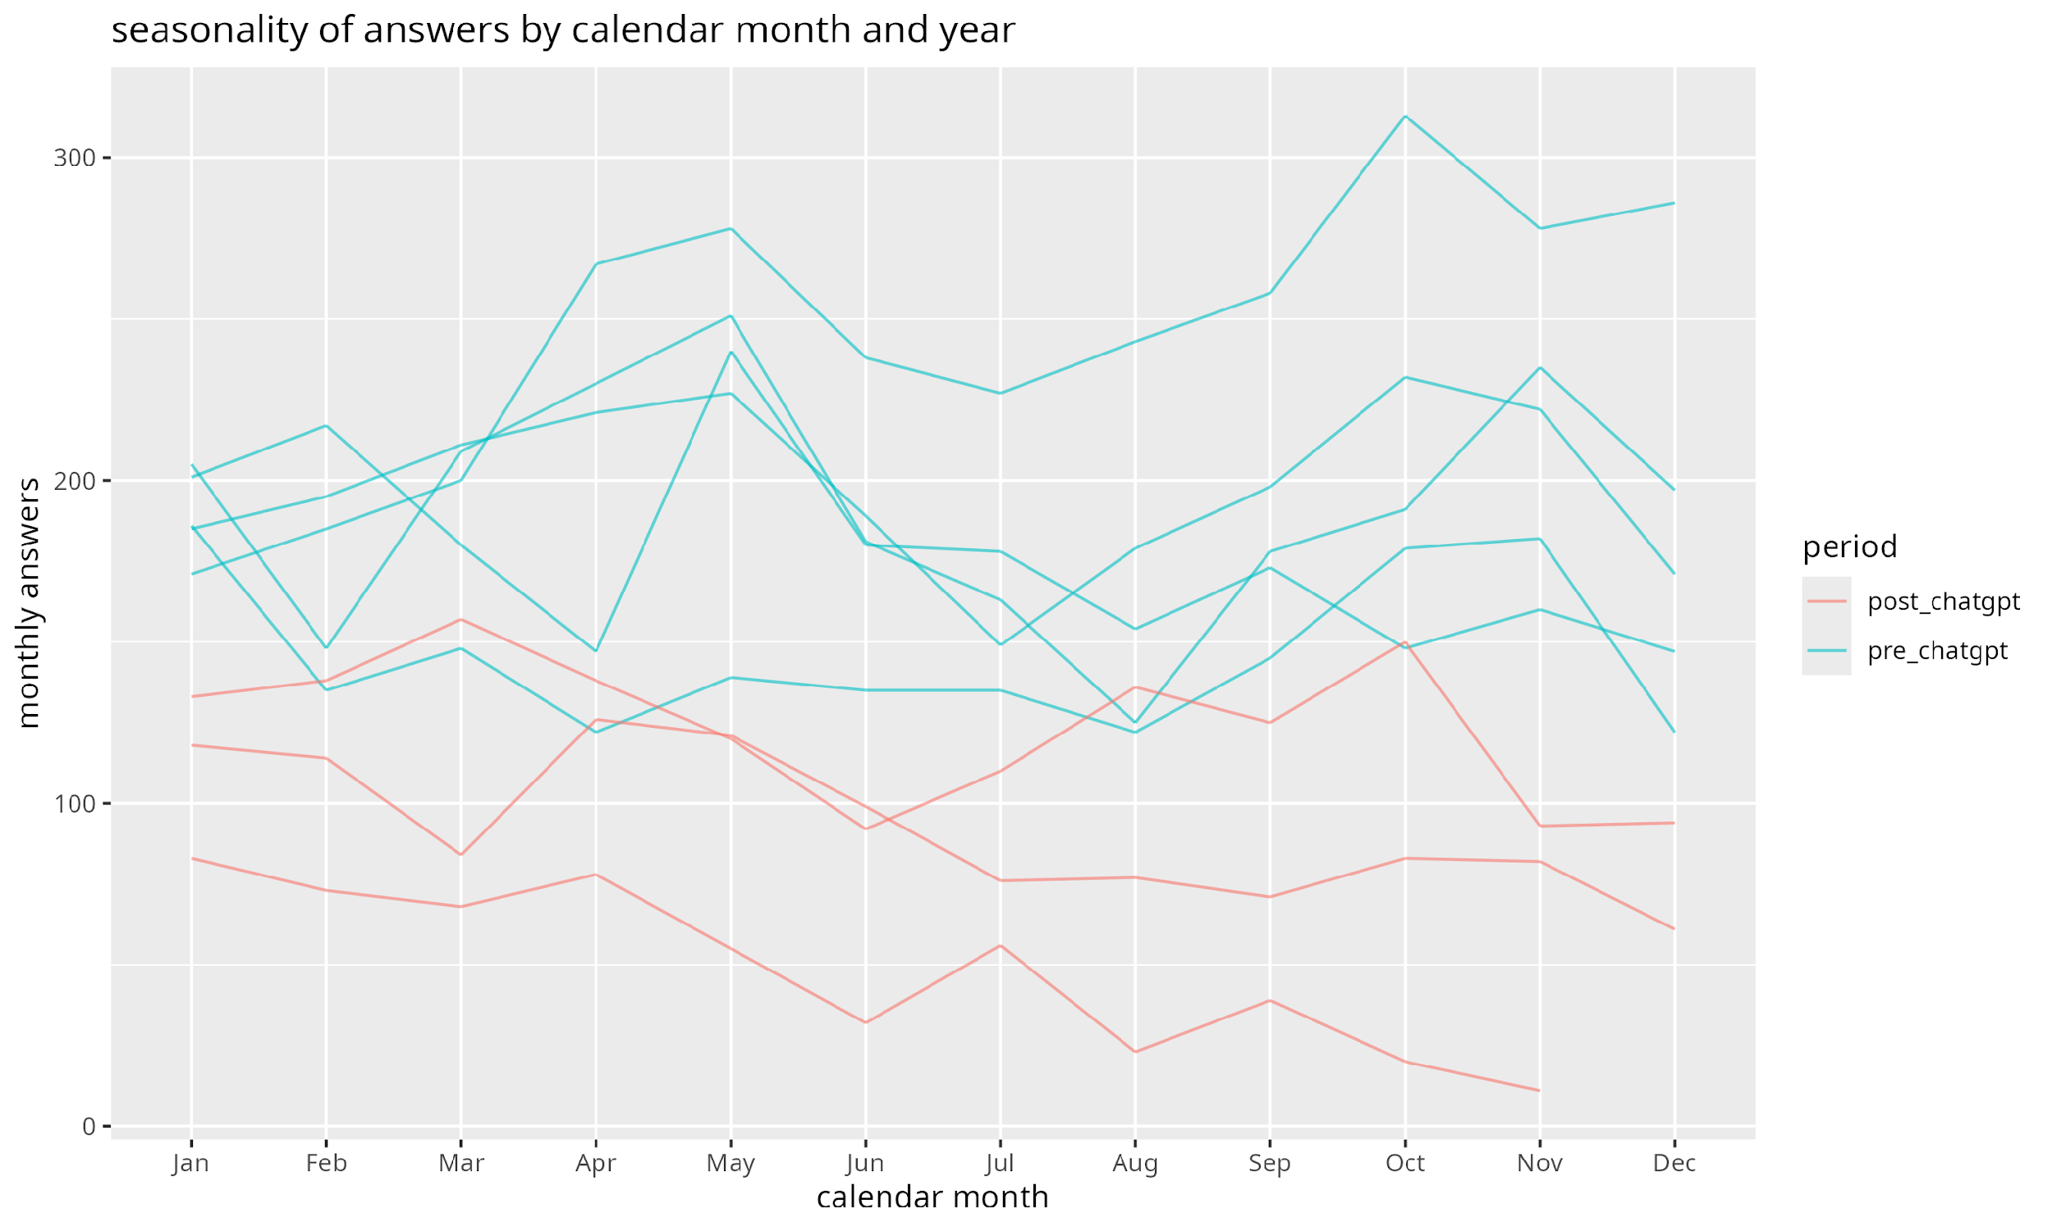
Preliminary Patterns
Notes:
Long‑run decline in answers with a marked break around ChatGPT’s debut. Recurring seasonal dips are visible (summer holidays, year end)

Slide 5


Methodology
Interrupted Time‑Series
Linear regression with level and slope breaks; controls for time and seasonality.
Poisson/NegBin Models
Count regressions to handle overdispersion; same predictors as ITS.
ARIMA Forecasting
Fit on pre‑event data to generate counterfactual; compare to observed post‑event values.
Survey Logistic Models
Predict probability of being a frequent visitor as a function of ChatGPT usage and covariates.

Slide 6
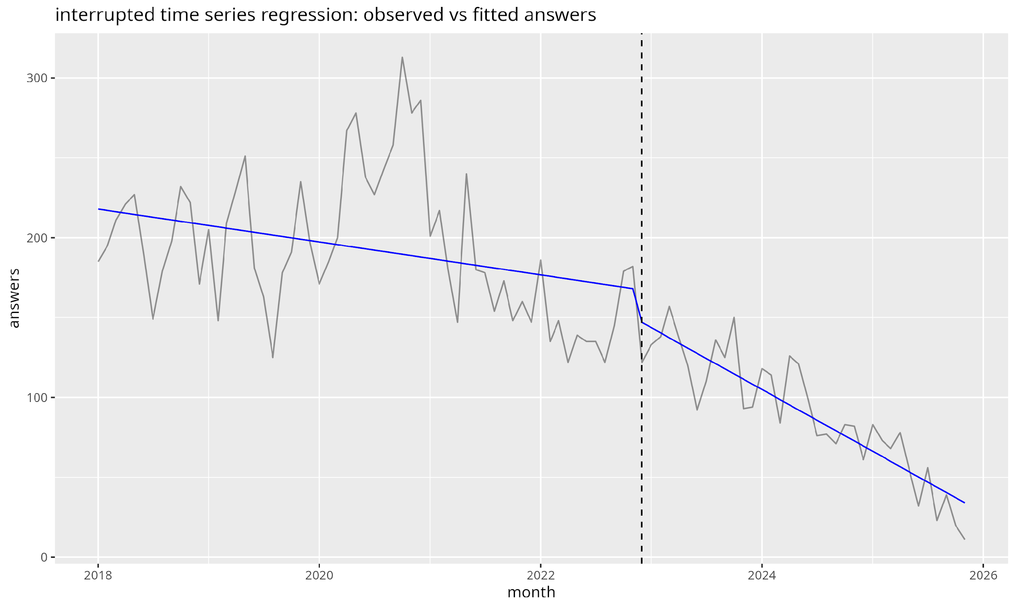
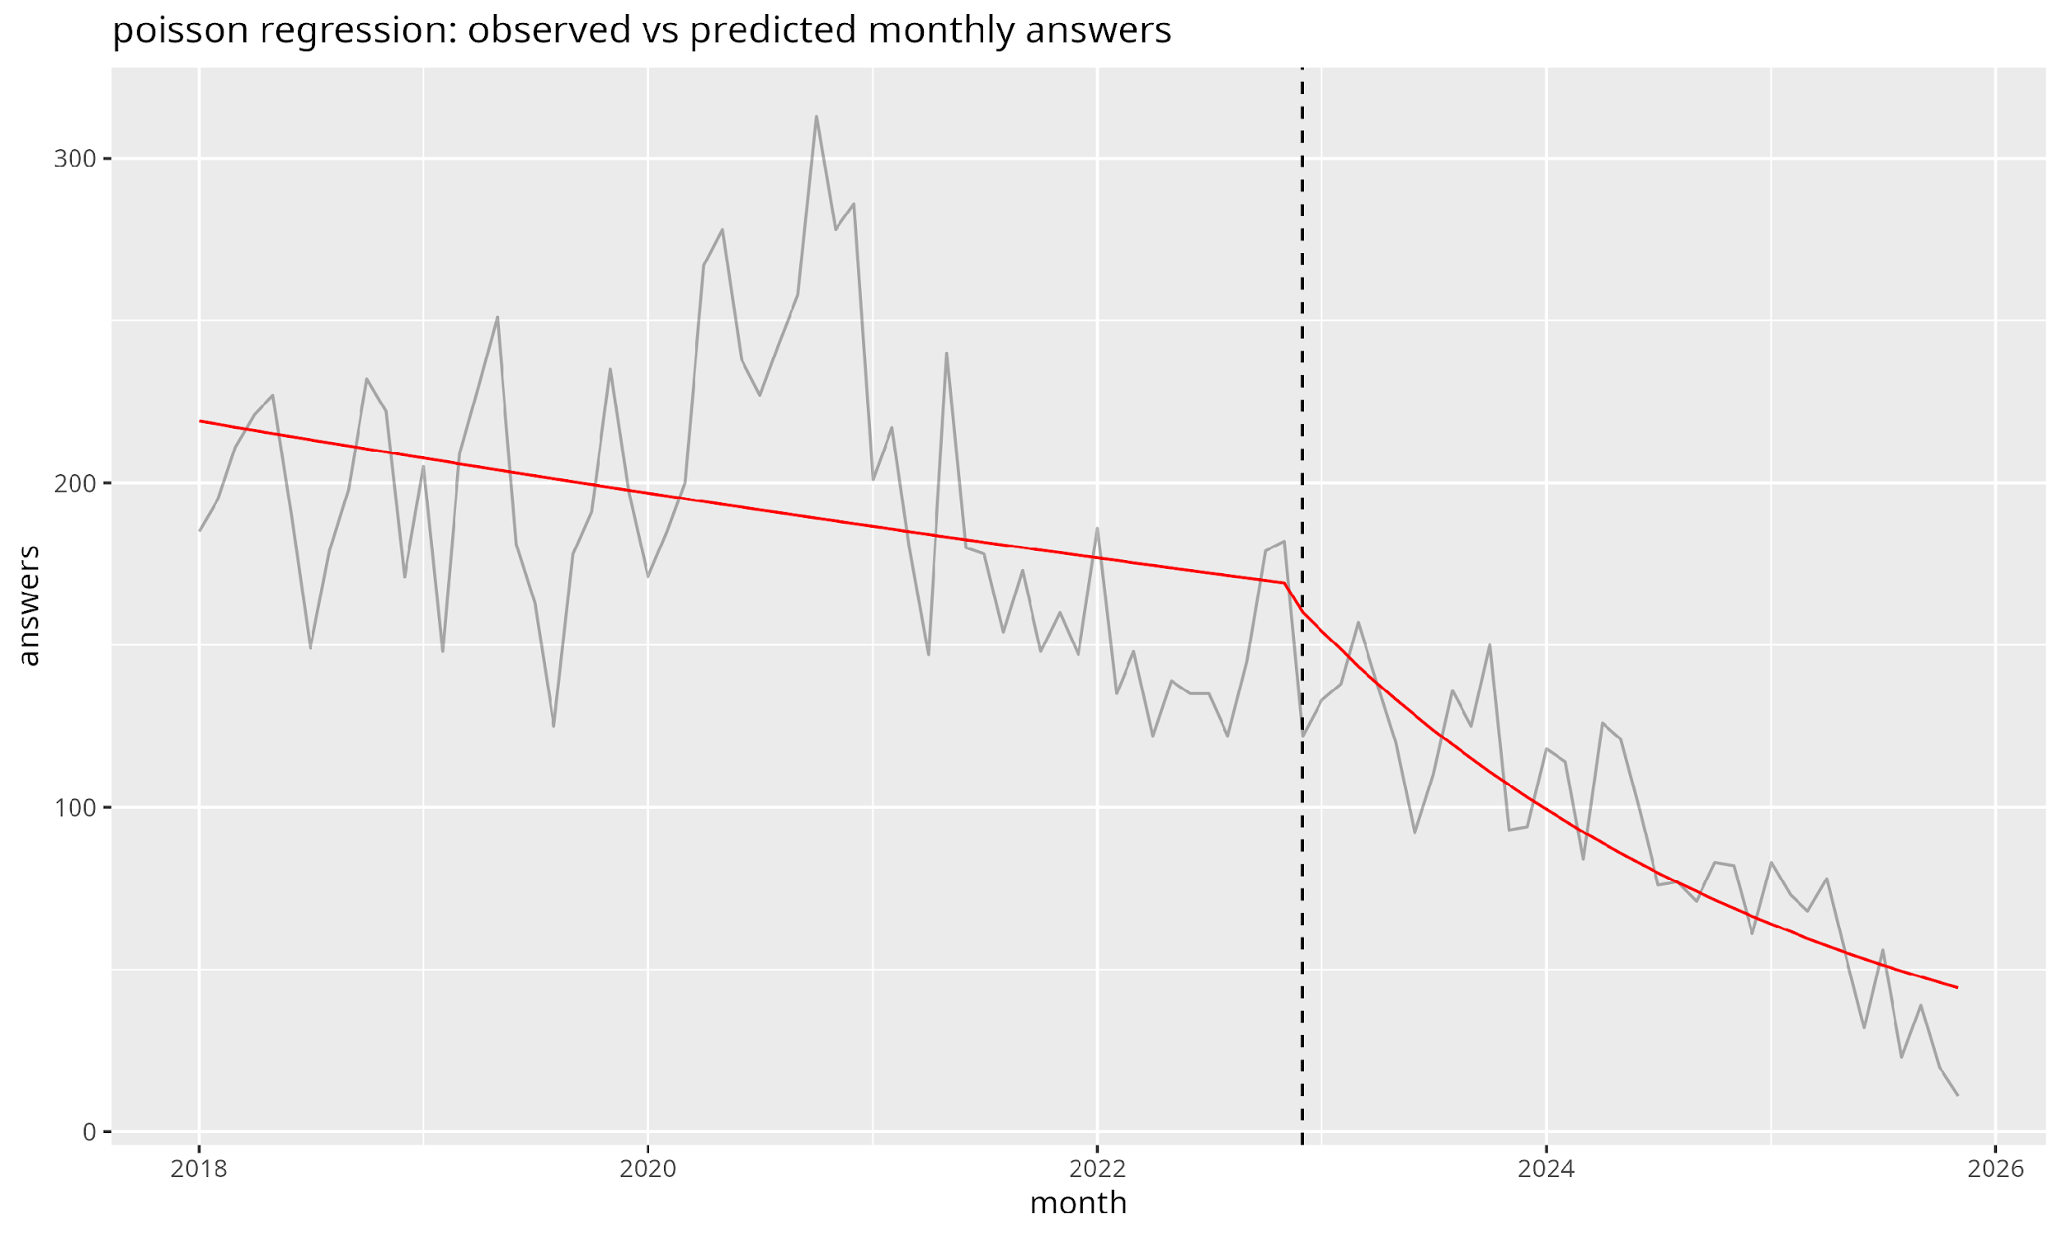
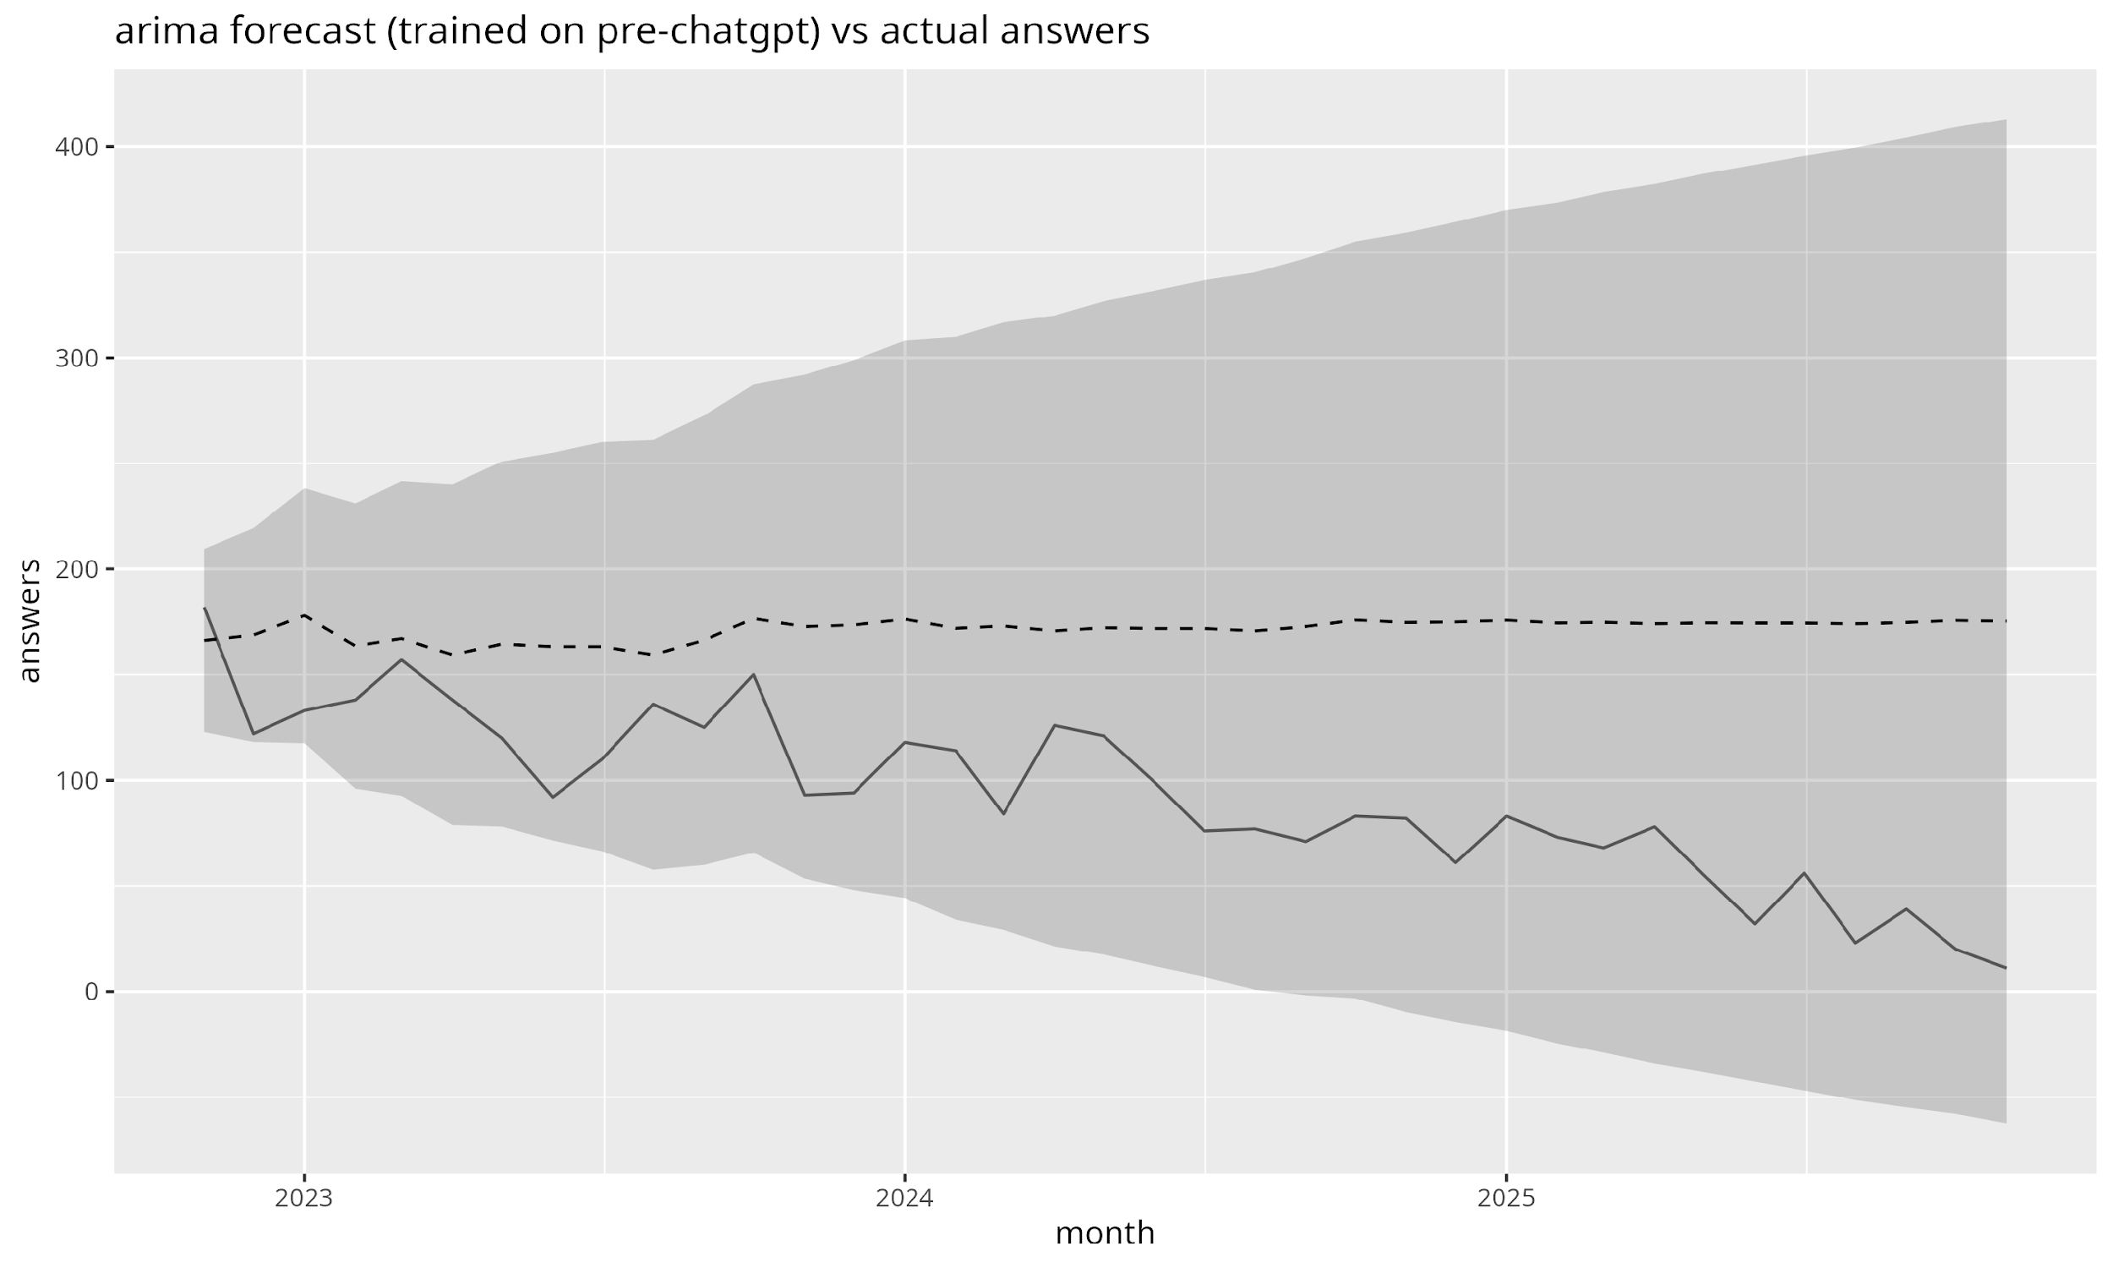
Model Fits & Counterfactuals
LM Fit
Level drop and slope change visible.
Poisson Fit
Handles overdispersion; similar pattern.
ARIMA Forecast
Counterfactual baseline vs. observed drop.
All models agree on a structural break following ChatGPT’s release

Slide 7
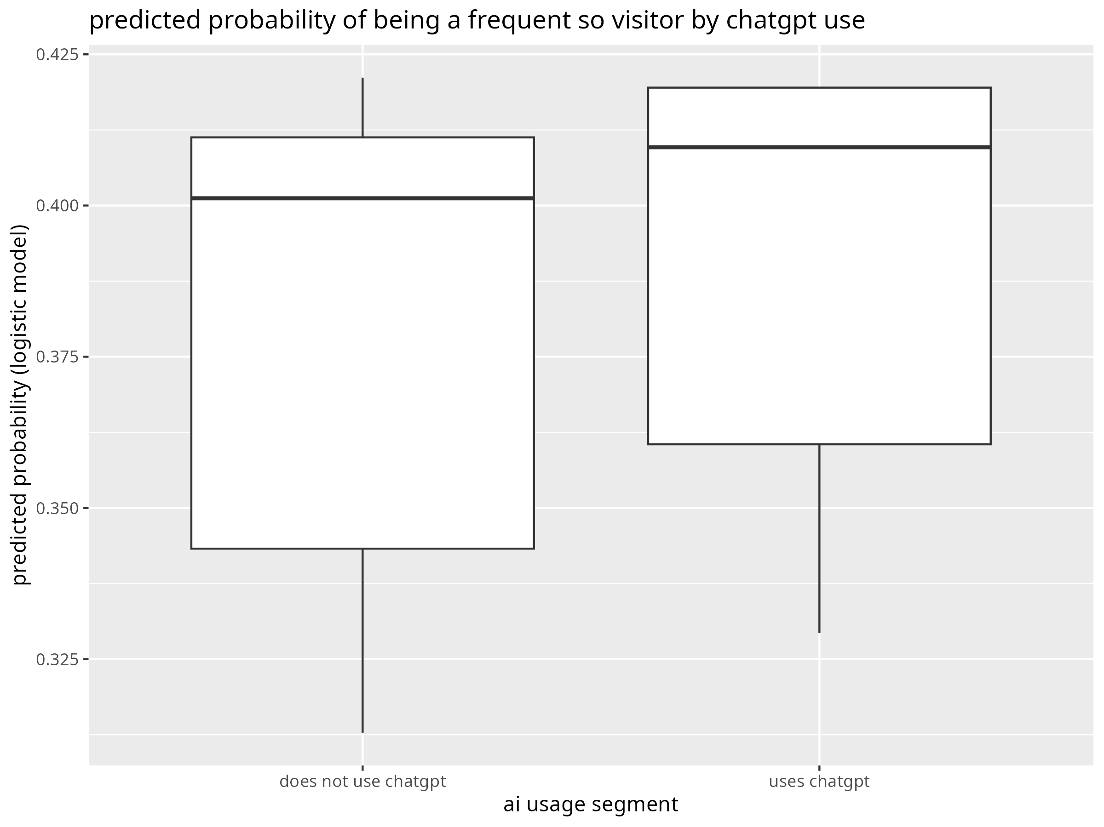
Survey Results
ChatGPT adoption is widespread, especially among heavy coders
Self‑reported ChatGPT use does not significantly distinguish daily visitors from others; age and year matter more

Slide 8
Key Findings
Monthly answers dropped sharply after ChatGPT’s release and continued on a lower trend.
Policy and moderation events aligned with further dips, suggesting compounding effects.
ARIMA counterfactuals confirm deviations well outside forecast bounds.
Survey evidence shows a substitution effect: heavy ChatGPT users visit SO less often.

Slide 9
Limitations
Causality remains tentative: multiple overlapping events confound attribution
SEDE data may exclude shadow moderation queues or private content
Survey responses are self‑reported and may not represent all user segments.
External factors (e.g., economy, other tools) could influence answer supply.

Slide 10
Implications and Future Work
Platforms must adapt to AI‑assisted workflows, balancing openness with quality control
Clear governance and AI policies can mitigate content shocks and maintain trust
Integrating structured answer APIs into conversational assistants could recapture engagement
Future research should explore tag‑level trends, user cohorts and synthetic controls

Slide 11
Thank You For Listening!

